Slide 1







Cute Cats

Slide 2





Welcome
Welcome to the world of fantasy! Join us on a journey to explore the mystical creatures, enchanted lands, and magical wonders that exist beyond our reality. Discover the wonders and secrets of this exciting realm and unlock the power of imagination.

Slide 3



Table of Contents
01
Introduction
02
Encounters
The Extraordinary Realm
Unicorn Sightings
03
Wonders
04
Magic
Wishes Granted
Spellcasting
05
Adventure
06
Conclusion
Happily Ever After
Embrace the Fantasy

Slide 4


Introduction
The Fantasy Realm: Uncovering the Secrets of the Imagination and the Magic that Lies Within

Slide 5

The Realm of the Extraordinary
Welcome to the Fantasy World, a realm of wonder and enchantment where anything is possible. Here, dragons breathe fire, unicorns prance through meadows, and rainbows shine brightly. This world is a place where wishes come true, where potions can be cursed and spells are cast. It's a place of treasure and adventure, where the impossible becomes possible. But the greatest treasure of all is the one that lies within.
The world of fantasy is a reflection of our deepest desires, our fondest dreams, and our wildest imaginations. It's a place where we can let go of the constraints of reality and explore the boundless possibilities of the human mind. In this introduction, we will delve into the mysteries of this realm, uncovering the magic and wonder that lies within. So come with us and let's embark on a journey through the Fantasy World.

Slide 6







Unicorn Sightings
A record of the number of unicorns spotted in the fantasy realm and the beauty and mystery that surrounds these enchanting creatures.
Dragon Taming
A closer look at the art of taming dragons and the brave adventurers who dare to take on these fearsome creatures.

Slide 7




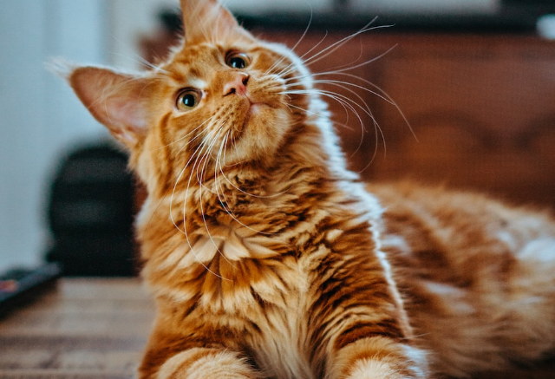
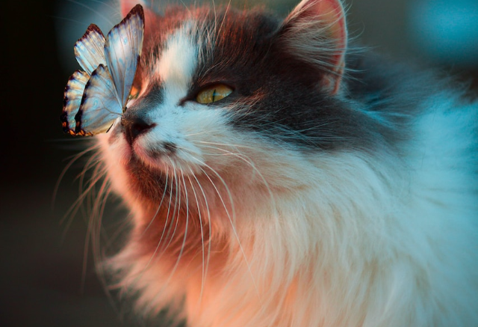
Unicorn Sightings
Dragon Taming
A record of the number of unicorns spotted in the fantasy realm and the beauty and mystery.
A closer look at the art of taming dragons and the brave adventurers who dare to take on these creatures.

Slide 8





Fantasy is the gateway to the impossible, the land where the ordinary becomes extraordinary, and the impossible becomes possible. It is the realm of the imagination, where anything can happen and everything is possible.
The Dream Weaver

Slide 9



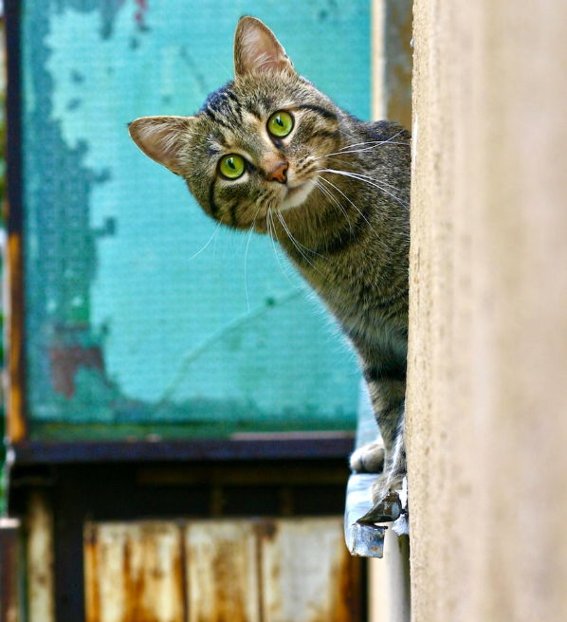




Dragon Taming Technique
A guide to taming and caring for dragons in the realm of magic.
The Art of Unicorn Sighting
Tips and tricks for spotting the elusive unicorns in their natural habitat.

Slide 10




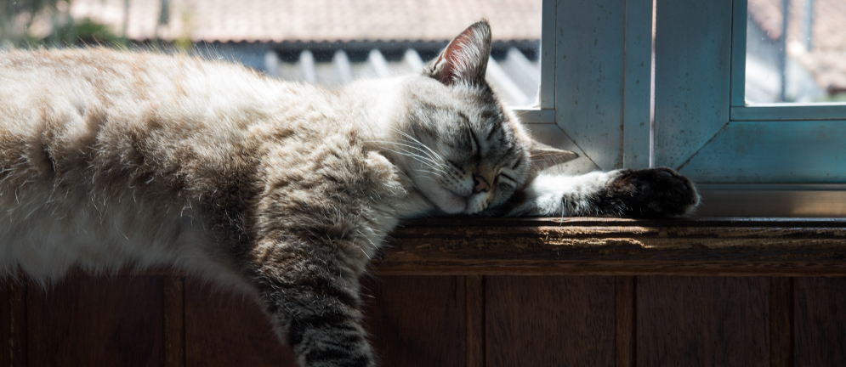


The Elves: A Glimpse into Their World
Elegant inhabitants of enchanted forests, known for their mastery of magic and their close connection to nature. They possess an innate sense of harmony and balance, making them protectors of the natural world.
"The Art of Archery": Discover the intricacies of the Art of Archery as practiced by the graceful and precise elves.
"The Life of an Elf": Learn about the customs and daily life of the elves, from their familial structure to their religious beliefs.

Slide 11
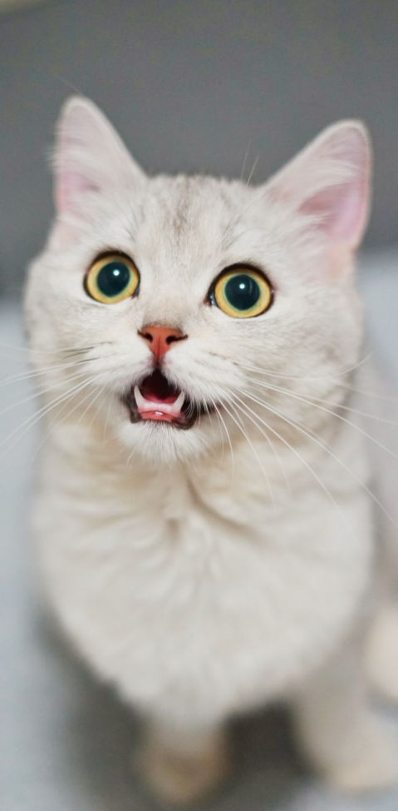

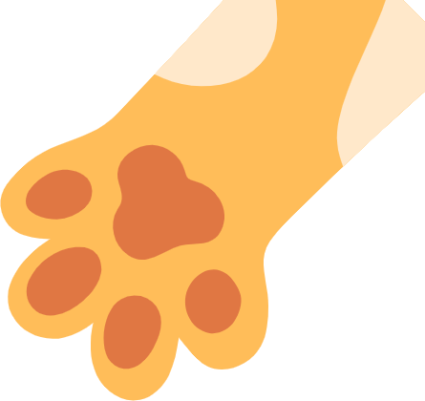

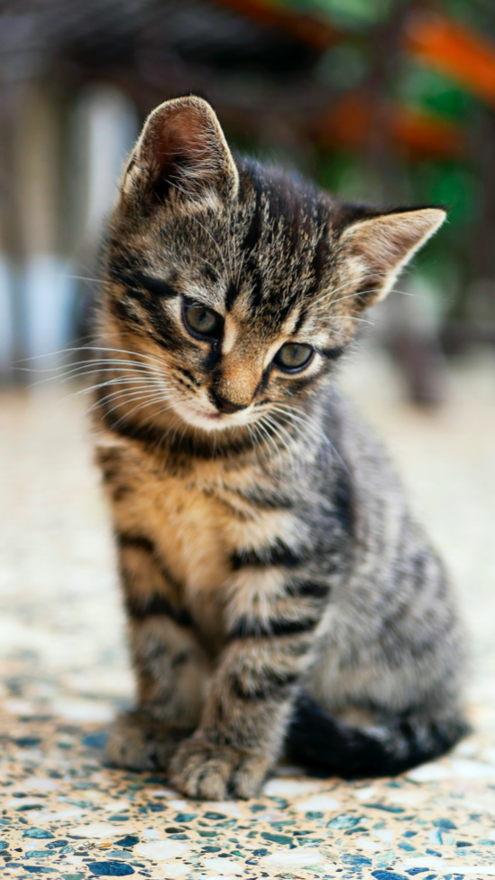
Some Data
75%
Enchanted Creatures
possess the ability to cast spells.
60%
Magic-Wielding Individuals
practice the art of illusions.
90%
Spells Cast
are dark magic, foretelling danger.

Slide 12


The Enchanted Forest
A magical forest filled with talking animals and enchanted creatures.
The Crystal Caves
A network of underground caves filled with precious gems and crystals.
The Dragon's Lair
A dangerous and mysterious place where dragons reside.
Fantasy Realm at a Glance

Slide 13
234,567
UNICORN SIGHTINGS
A tally of the number of unicorns spotted in the fantasy realm.

Slide 14





233 Coins
85%
Treasure Found
Wished Granted
456 Hours
535 Km
Duration of Spell Casting
Journey Distance

Slide 15


Mon
Tue
Wed
Thu
Fri
Sat
Sun
07:00
A rare eclipse occurs, causing strange and unpredictable magical effects across the land.
09:00
A group of adventurers sets out to recover an ancient artifact.
11:00
A volcanic eruption devastates a nearby city, forcing its inhabitants to flee to the safety.
13:00
A powerful sorcerer and a cunning thief cross paths, leading to an unlikely partnership.
15:00
An elf helps humans obtain the Crystal of the Unicorn from the Elven Forest.
17:00
The civilization of the Shimmering City is founded by a group of powerful wizards.

Slide 16
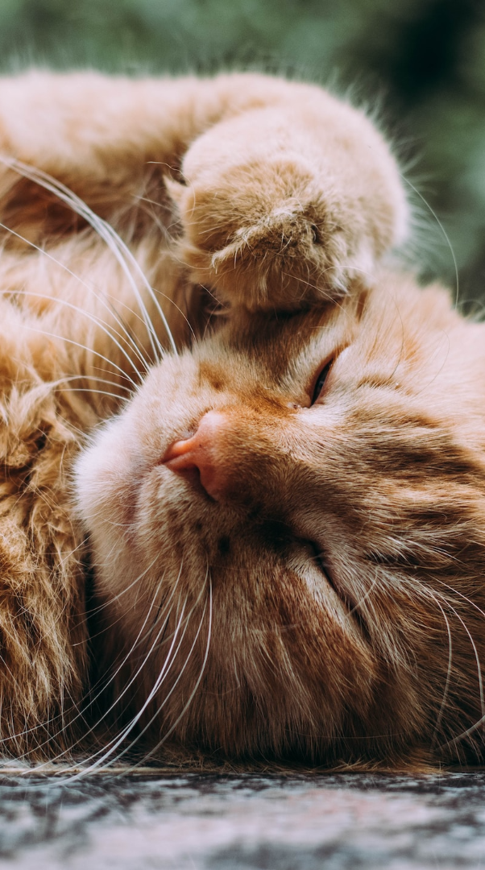

1
Discover the secrets
2
Find your own path
Explore the lush, vibrant forest and uncover the mysteries that lie within.
Choose your own path through the forest, and see where it takes you.
Meet the creatures
Uncover the magic
3
4
Encounter the mythical creatures that call the forest home, from talking animals to mischievous fairies.
Learn about the powerful magic that pervades the forest and how it affects all who enter.

Slide 17
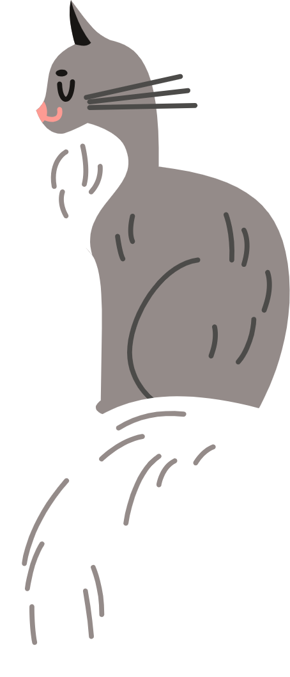

The Evolution of the Unicorn
"The Evolution of the Unicorn" is a study exploring the historical, cultural, and mythical development of the iconic fantasy creature. From its ancient roots in Mediterranean mythology to its modern-day representation in popular culture, this research delves into the various interpretations and beliefs surrounding the mystical horse with a single horn. The goal is to understand the evolution of this captivating creature and its enduring place in human imagination.

Slide 18

The Information
Spellcasting Competition
Treasure
Adventure
A significant event in the history of the fantasy realm, in which the greatest spellcasters of the realm in tournament.
A significant event in the history of the fantasy realm, in which a massive and awesome treasure hunt was organized.
A notable year in the history of the fantasy realm, in which a large number of adventurers set out to explore.

Slide 19

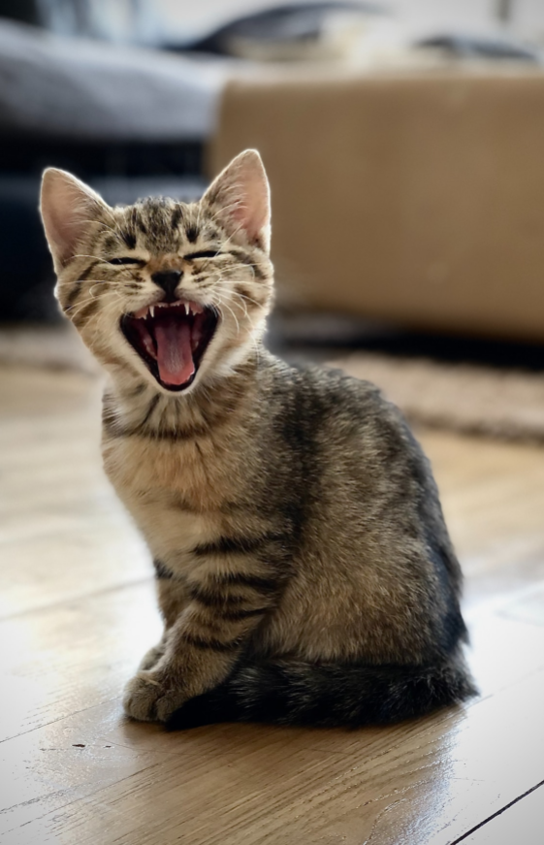




The Mystery
The Forbidden Forest: A place of mystery and wonder, where mystical creatures roam and enchanted flora flourishes.
The Crystal Caves: A network of glittering caves filled with precious gems and minerals, guarded by fierce beasts.
The Enchanted Garden: A place of pure beauty and tranquility, where the colors of the flowers are more vibrant.

Slide 20








Thank you for choosing EaTemp
We offer free and high-quality slides templates for your presentations. We appreciate you choosing us and hope our templates have been helpful.
As a new website, we rely on your support to grow, so please help us by sharing our site with your friends and colleagues.
eatemp._
@eatemp
eatempofficial
@eatemp.official

